Slide 1
Hello Elixir!
Sameeri Marryboyina

Slide 2







Thank you sponsors

Slide 3
About me
Sameeri Pavan Kumar Marryboyina
Hyderabad, India
I can communicate in Telugu, Hindi, English, German(very little)
MS in Computer Science, The University of Oklahoma
Senior Software Engineer, Telogical Systems LLC
Full Stack JS - React, Redux and its Ecosystem, Node, Express
Norman, OK

Slide 4
Being a polyglot...
WORK | SCHOOL | LEARNING | RADAR
JavaScript | C | Elixir | Elm
C# | C++/VC++ | Erlang | TypeScript
Ruby | COBOL |  | Python
Java | Assembly |  | Scala
 |  |  | Rust
 |  |  | Go

Slide 5

But, What does it mean to be a Language?

Slide 6
A Language…
Alphabet
Constructs
Syntax
Semantics
Type System (Static vs Dynamic)
Translation Model (Compiled vs Interpreted)
Execution model
Runtime Mechanics
Specification
Implementation

Slide 7
The process – From Human thought to something magical

Slide 8
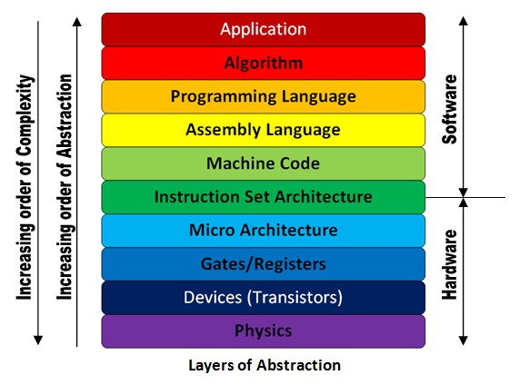
The Machine stack – Layers of Abstraction

